Slide 1

Data Visualization

Slide 2
Why are We Here?
To Develop a Personal and Intimate Relationship With R
To Install Some Key R Packages
Tidyverse
Rmarkdown
To Practice Coding via R Scripts
To Learn Elements of ggplot2
Practice Making Visually Stunning Pictures that Change Lives

Slide 3
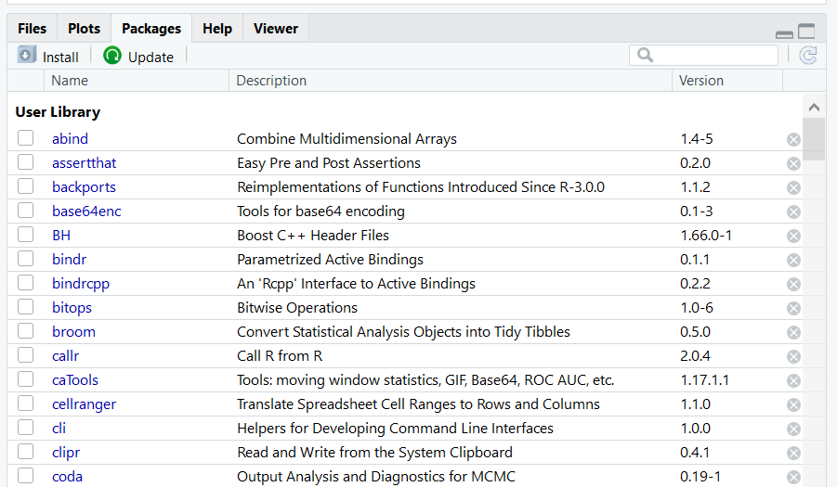
Initial Steps in RStudio
Install Tidyverse Package
Other Packages To Be Installed
RColorBrewer
Rmarkdown
> install.packages(“tidyverse”)
Select Install and Search on CRAN

Slide 4
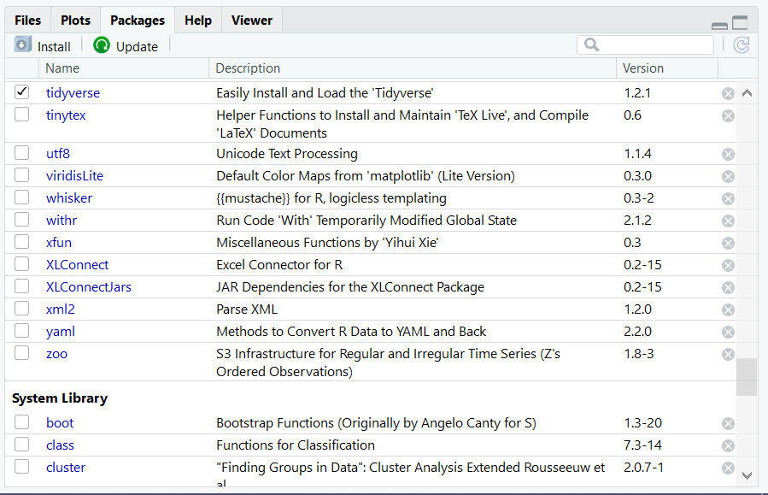
Initial Steps in RStudio
To Use the Package
Code
Check Box for Tidyverse
> library(“tidyverse”)

Slide 5
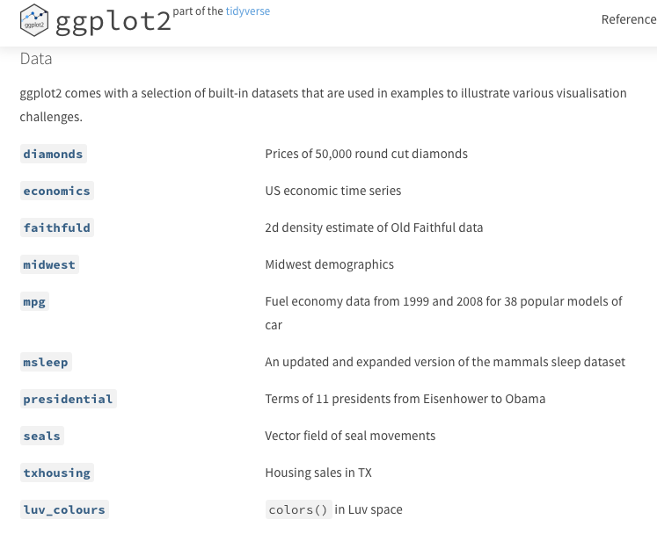
ggplot2
Help Page: Link
Comes with Preloaded Datasets

Slide 6
ggplot2
Many Useful Plots and Charts Provided
See Cheat Sheet: Link
(Also on Course Website)
Called Geoms (Geometric Objects)
The Geom you choose Must Comply with the Type of Variables You are Analyzing
Organized by Type of Data
Univariate
Bivariate
Mixtures of Categorical and Numeric

Slide 7
ggplot2
ggplot2 General Form
Fill in Blank With Name of Data in R
> ggplot(data=_____) +
geom_TYPE(mapping=aes(x=___,y=____, etc.))
Fill in Blanks from Variables in Data

Slide 8
Many Examples
Locate Supplement on Website
Download Zipped Folder and Unzip
Open Rmd File on Computer
Knit the Rmd File to HTML format
View Graphs with Me

Slide 9
Closing
Disperse and Make Reasonable Decisions

